Slide 1
Lecture-10 Birth of Bangladesh
Ananna Zulfiqar Showly
Lecturer
Department of Social Science
BUFT

Slide 2
Creation of Two States:
After world war II British were pressured to reduce the size of their empire.
Lord Mountbatten agreed for the partition of British India.
Britain declared two states Pakistan & India.
Pakistan was separated by East and West, and they were separated by thousands of miles of Indian territory.
The East and West were also very different in the way of their culture and the West area dominated the political ways of the country.

Slide 3
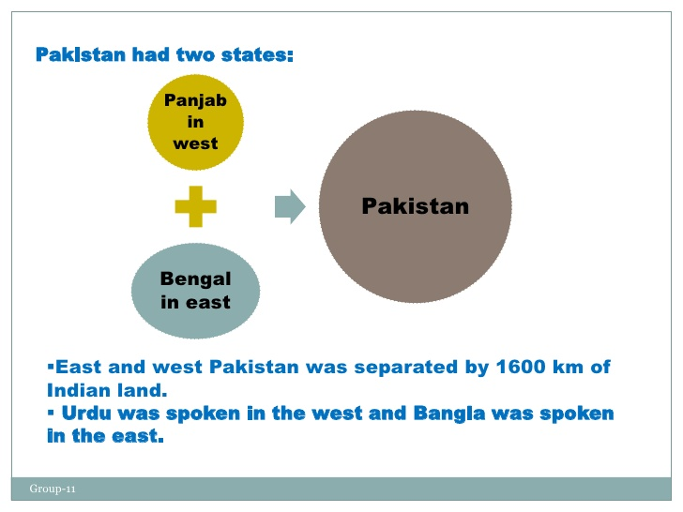
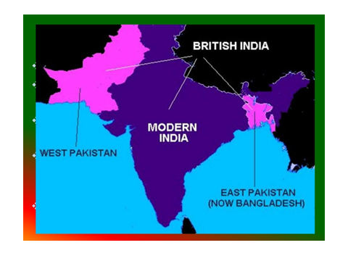
Pakistan State
Pakistan had two states: West Pakistan & East Pakistan.
Pakistan was separated by thousands of miles of Indian territory.
Urdu was spoken in the west and Bengali was spoken in the east.

Slide 4
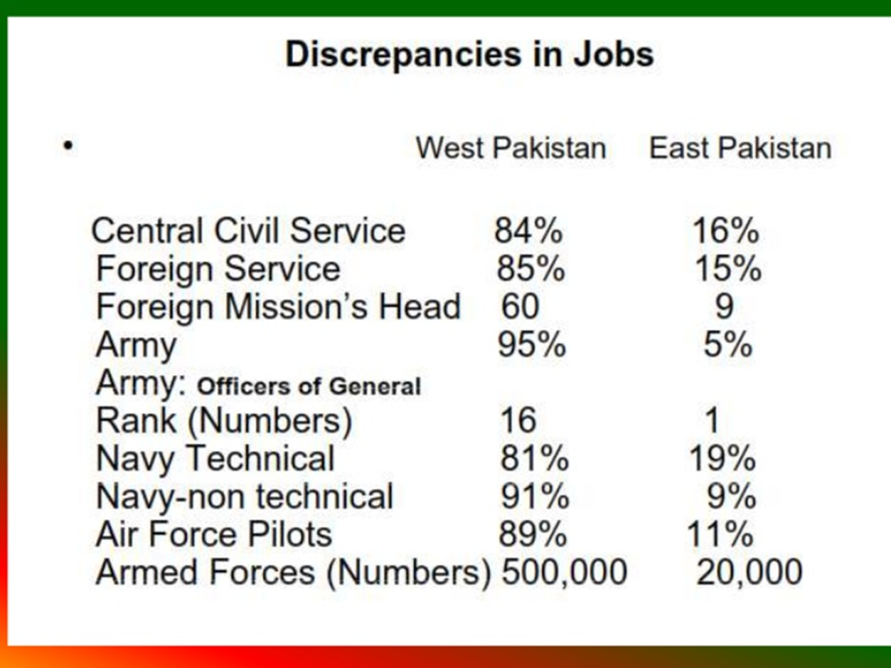
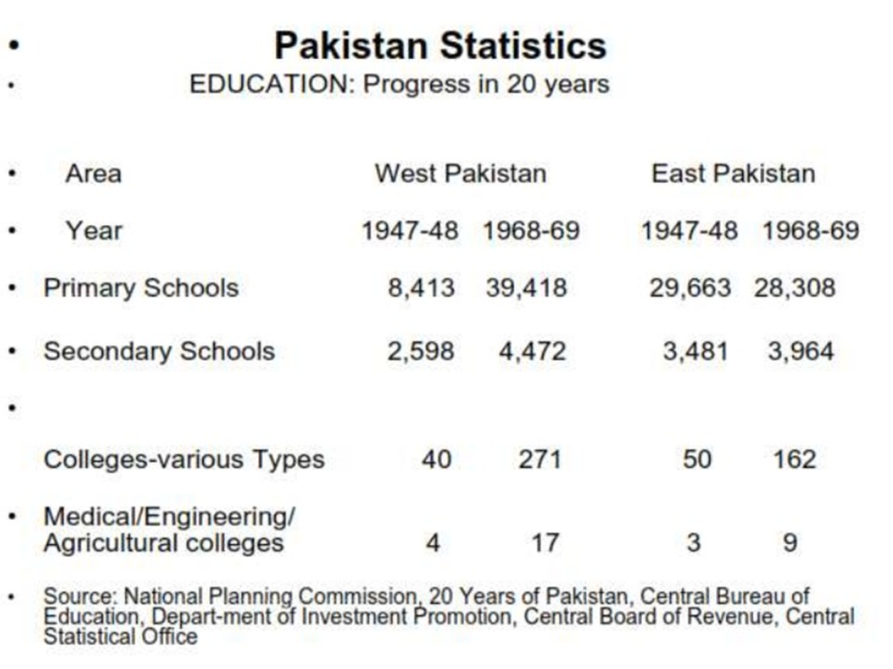
Background of Independence
The East and West were also very different in the way of their culture and society.
The West area dominated the political ways of the country.
Many discriminations were reportedly existing between East and West Pakistan on the societal, cultural, economical and political level.
Bangladesh had very poor representation in civil services and Arm forces as well as in commerce and industries.
Disparity in allotment of budget and development of state.
These discriminations lead to the independence of Bengal.

Slide 5

Language Movement (1952)
The conflict started when the subsequent state authorities declared that Urdu should be state language of the whole Pakistan.
Urdu was a language spoken by only 6% of people while ignoring the language of 54.6% people.
The protest culminated in students-police conflicts in the streets of Dhaka in 21 February 1952 leaving huge blood-shed.
Finally after years of conflict the central government granted Bengali as official state language of Pakistan.
21 February is now celebrated as the International Language day since 2000.

Slide 6
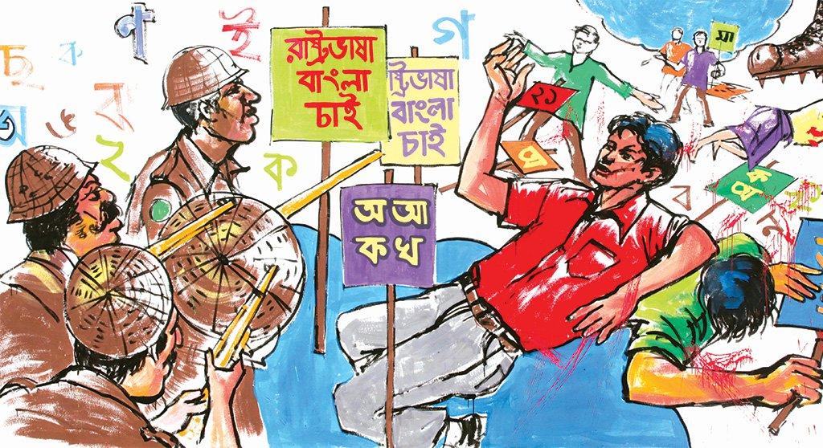

Slide 7
Importance of Language Movement
The Language Movement is one of the most important days in our history.
It has been suggested that the freedom struggle of Bangladesh originated from the Bengali language movement. In a way this is correct, as the basic inspiration for the freedom struggle of the Bengali-speaking people of Pakistan came mainly from linguistic nationalism.
Language is the prime carrier of a culture. It is also the most powerful instrument of preserving and developing our tangible and intangible heritage. During the course of world history, many cultures and civilizations have been shattered, devastated and crushed because of the demolition of their languages.

Slide 8
Language is not only the principal representative of a culture of one nation but it also creates sense of patriotism and nationalism in people’s mind. Bengali and Bangla language is an appropriate example of that.
Bengali people created one of the greatest political and cultural histories in the 20th century. The events of 21 February 1952 proved that a nation which is strong and powerful politically cannot destroy a spirited civilized nation if they have a unifying language like Bangla.
The General Election of 1954 and the language Issue: In March 1954, The United Front pledged that if they won in election, the following steps would be taken:
Bengali will be made one of the state languages of Pakistan.
Arrangements will be made to impart education through the mother tongue only.

Slide 9
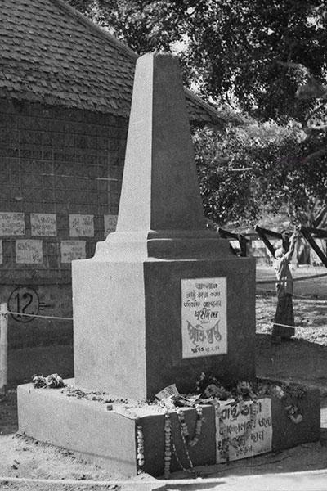
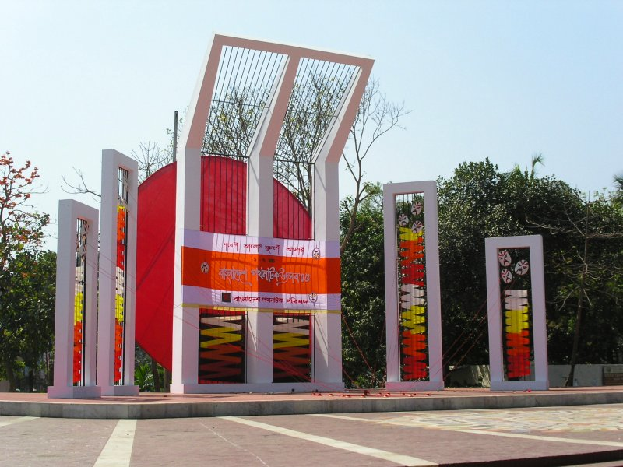
The first Shahid Minar. This photograph was taken on Feb. 24, 1952.

Slide 10
Six Points Movement:
In February 1966, in a Conference in Lahore for restoration of democracy, Sheikh Mujibur Rahman declared the historic six points demands calling for:
Pakistan should be a federation of states with parliamentary system of government;
Only defense and foreign affairs should remain with the federal government;
There should either be separate currencies for the two wings or one currency for the whole country with its inter-wing flow to he regulated by the reserve banks of the two wings;
Taxes to be levied only by the regional governments, but a specified portion will automatically go to the federal account;
Separate accounts to be maintained for foreign currencies earned by each region; and
A separate militia or a paramilitary force to be created for the eastern wing.

Slide 11
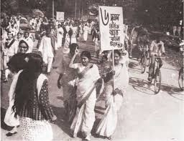
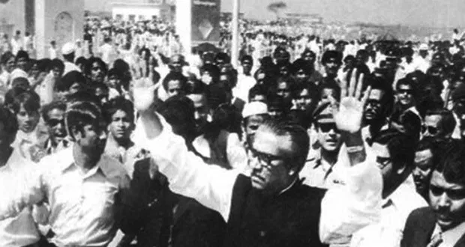
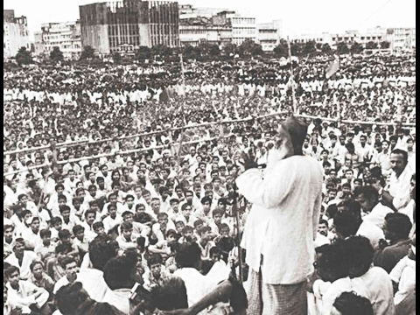
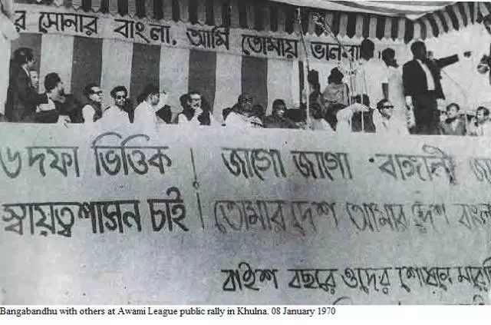

Slide 12
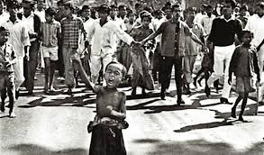
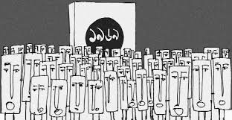
Mass Upsurge of 1969
It was in line with the six points movement and against the military dictatorship of Ayub Khan.
Another vanguard of the anti-Ayub Mass Movement was the 'All Party Students Committee of Action’
All these directed to the fall of Ayub’s regime.
It was during the mass movement of 1969 that Bengali nationalism reached its highest point.

Slide 13
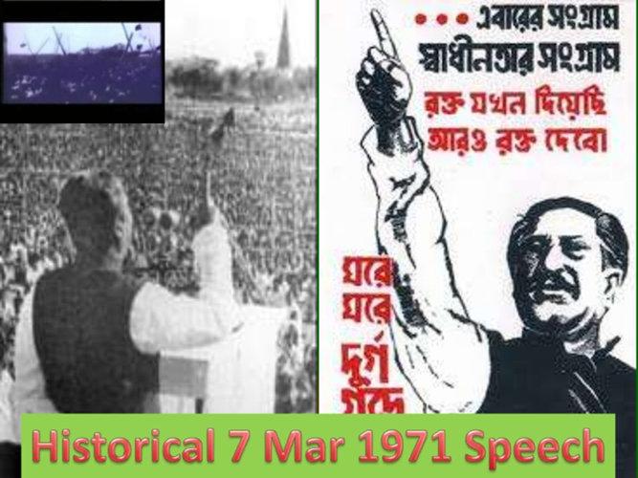
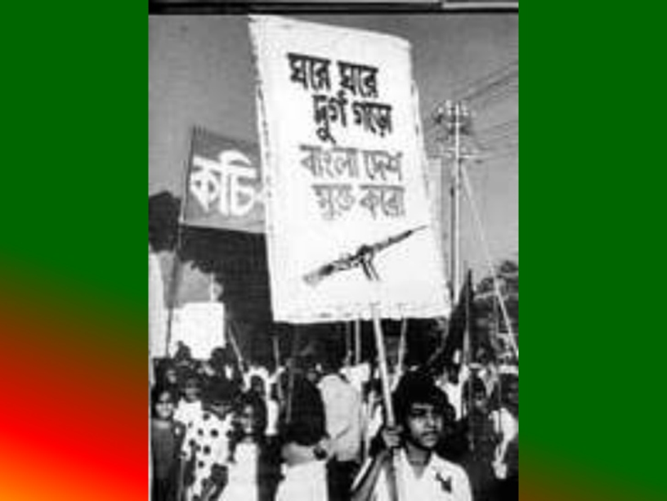
Call for Independence
After several years of political unrest the first election of Pakistan was called in 1970.
Awami league won all the seats in East Pakistan.
During the negotiations, the West Pakistani refused to accept the 6-point program and also refused to let Awami League to form government.
On March 7, 1971 Sheikh Mujibur Rahman made his historic freedom speech which called for the revolution for liberation.

Slide 14
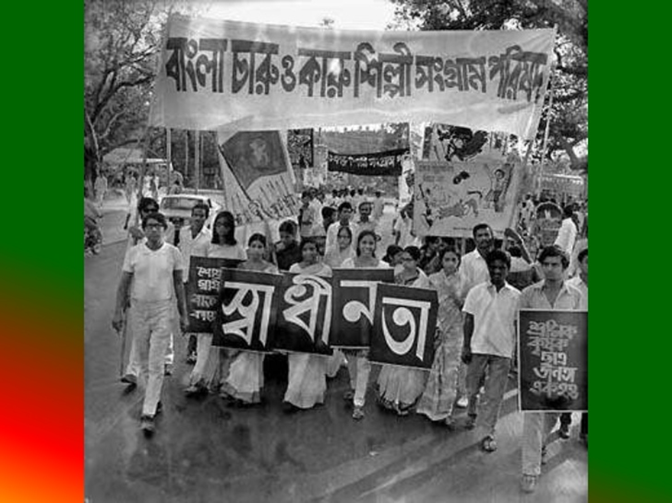

Slide 15
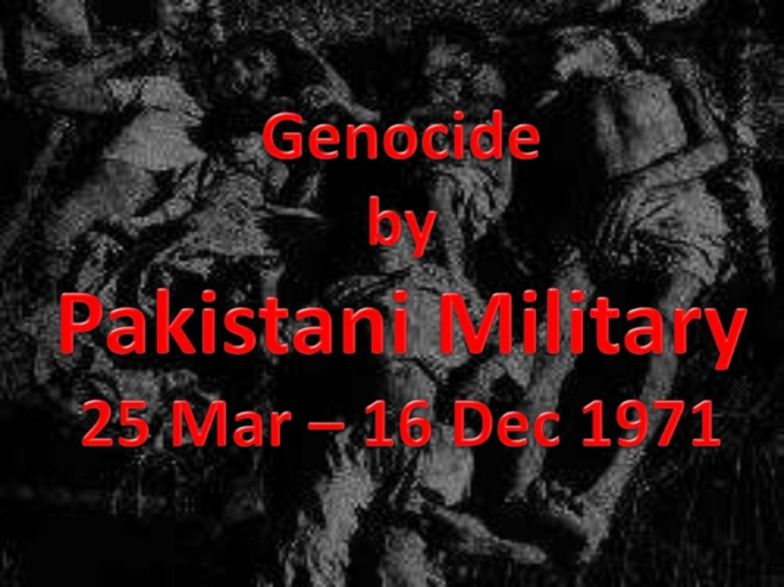

Slide 16
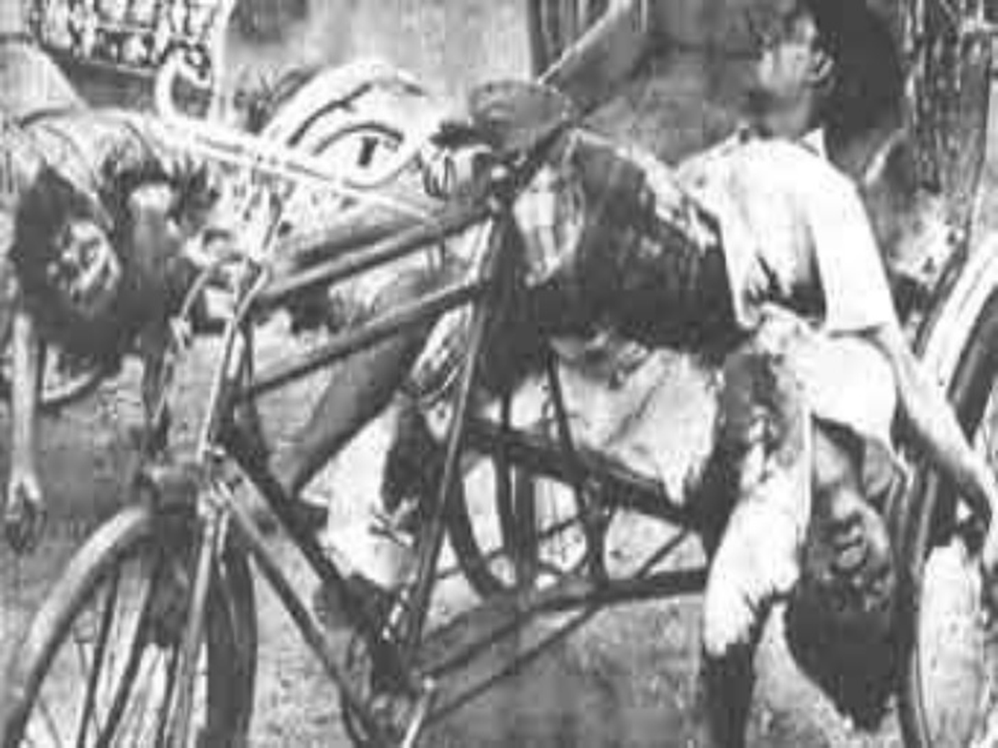

Slide 17
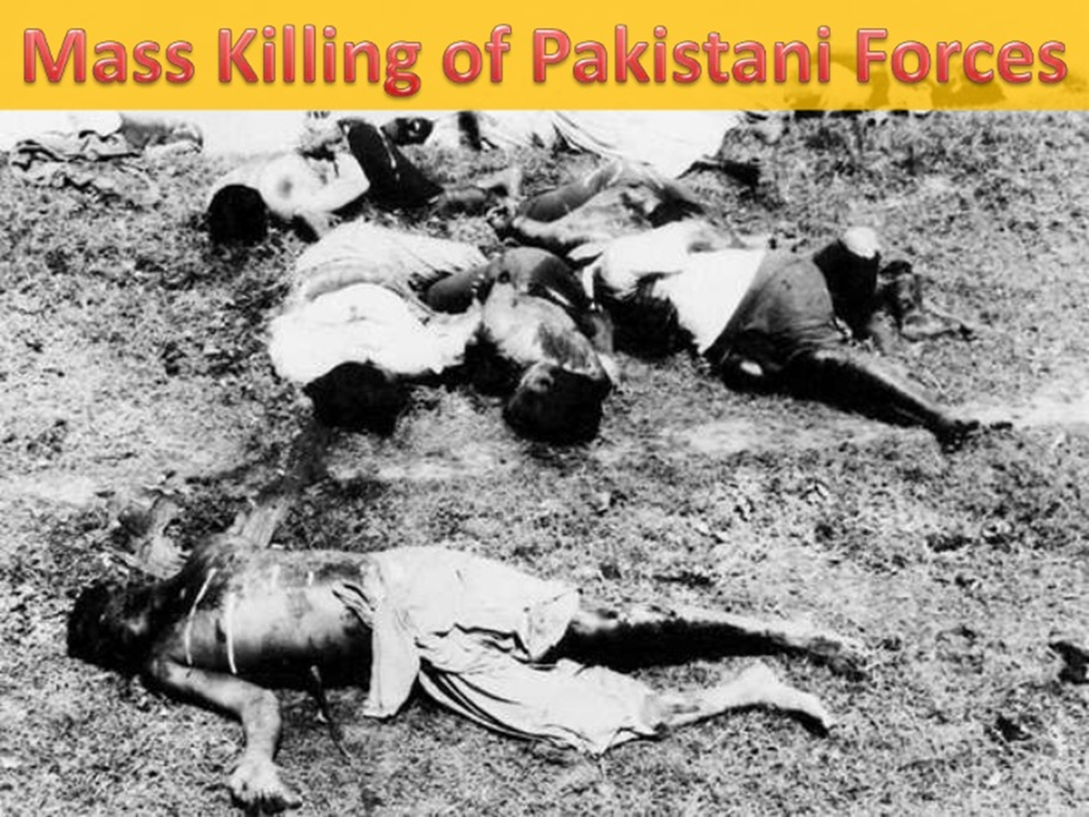

Slide 18
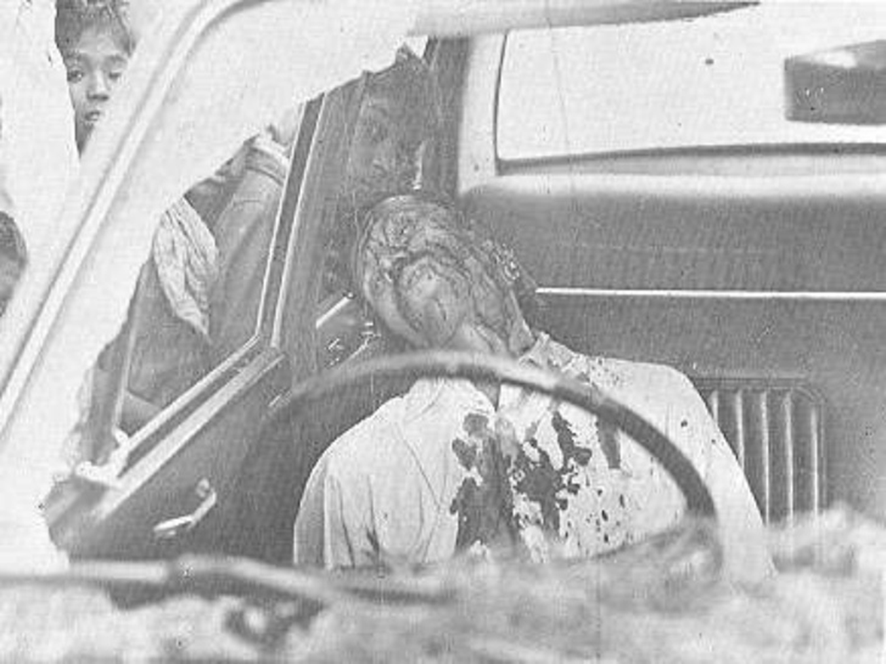

Slide 19


Slide 20
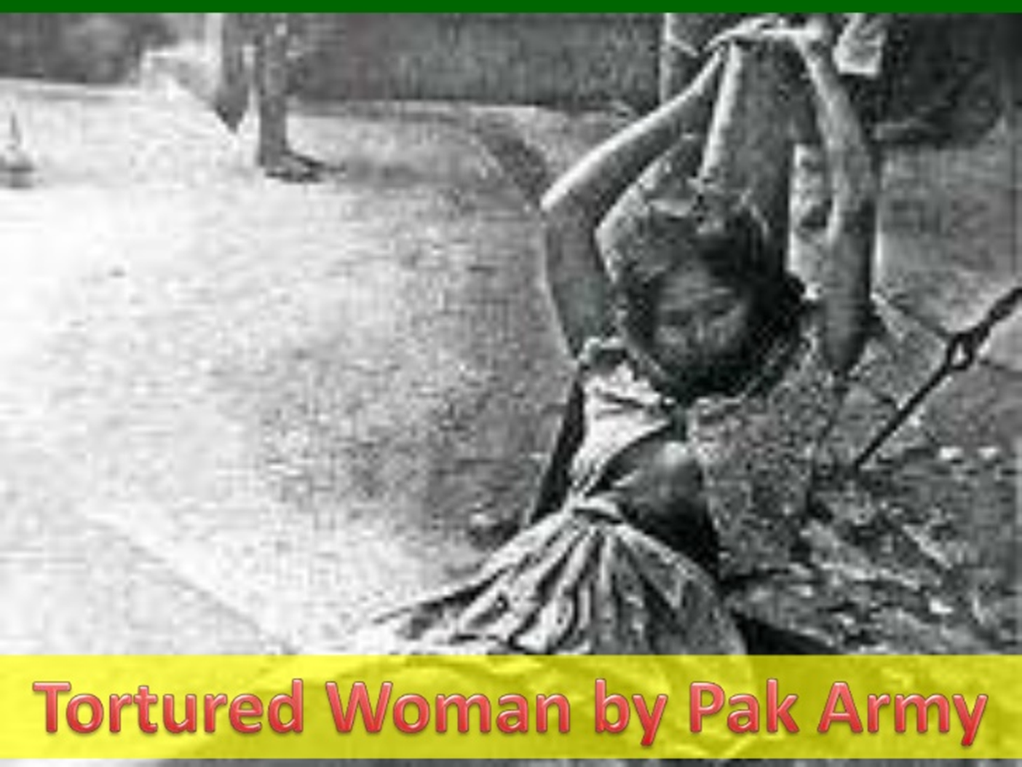

Slide 21
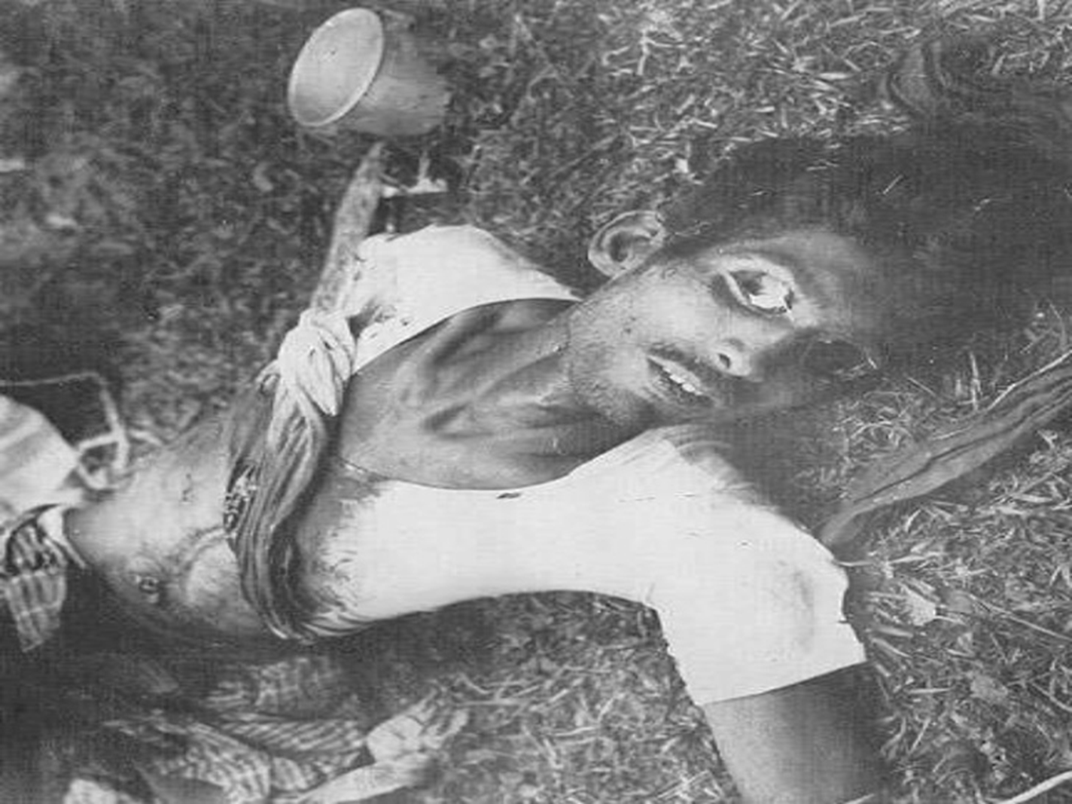

Slide 22
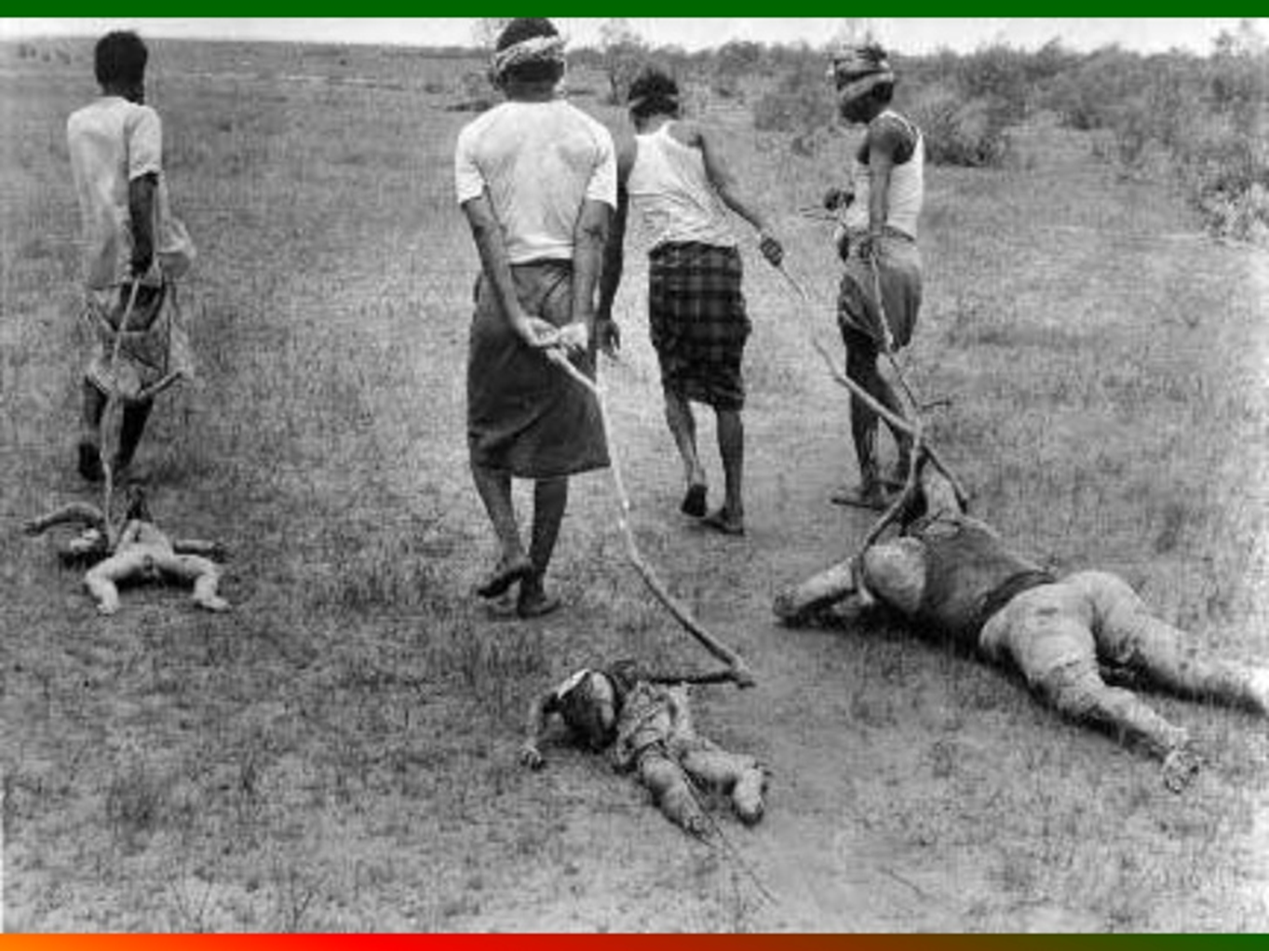

Slide 23
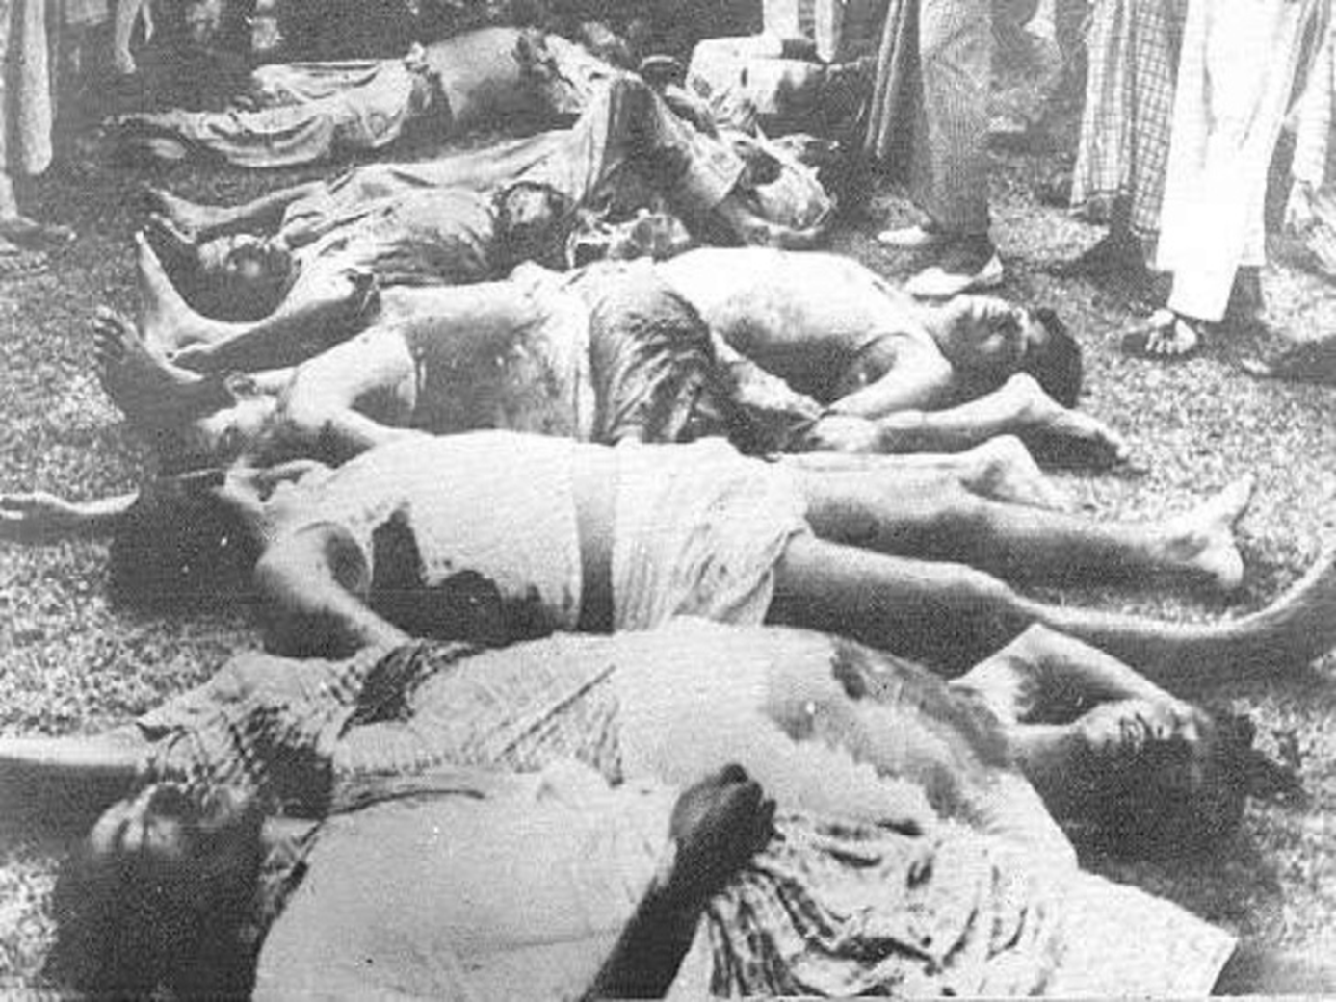

Slide 24


Slide 25
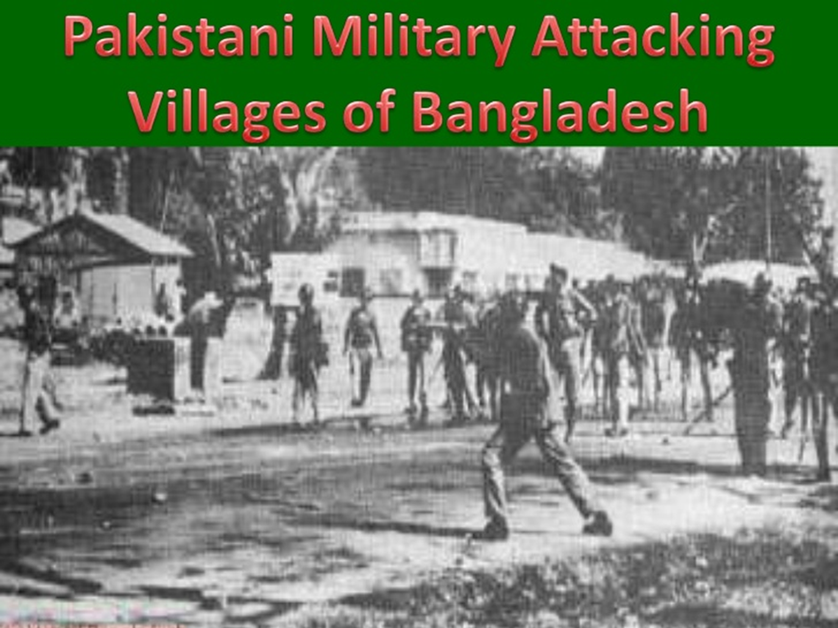

Slide 26
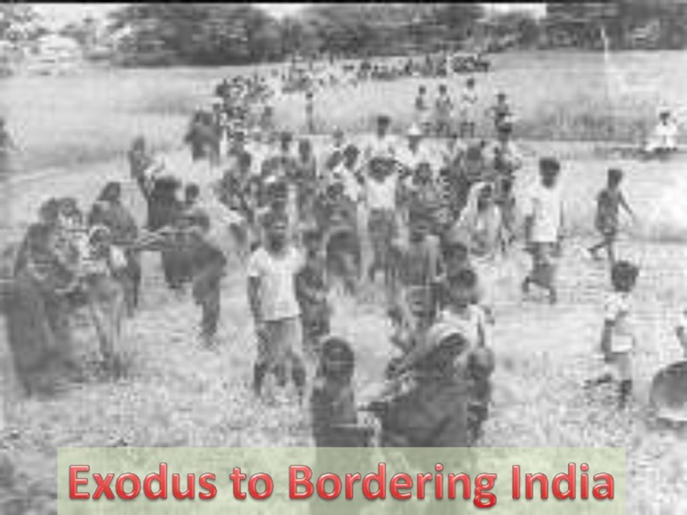

Slide 27
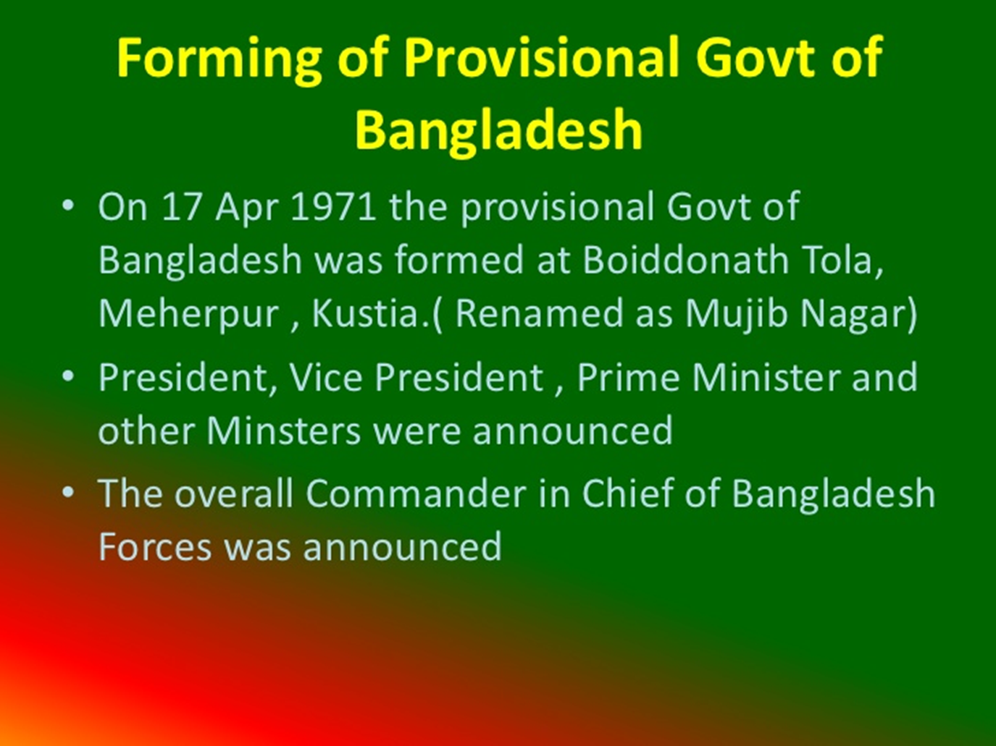
On 17 April 1971

Slide 28
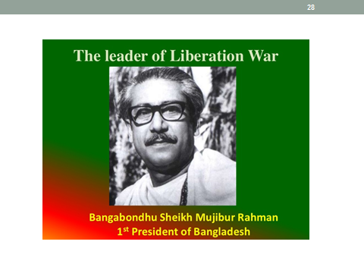

Slide 29
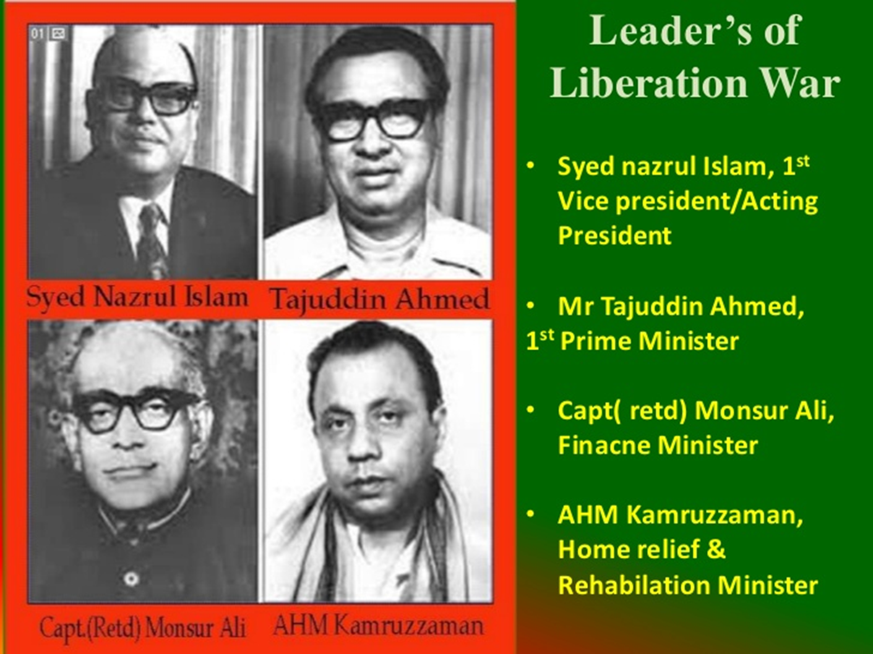

Slide 30
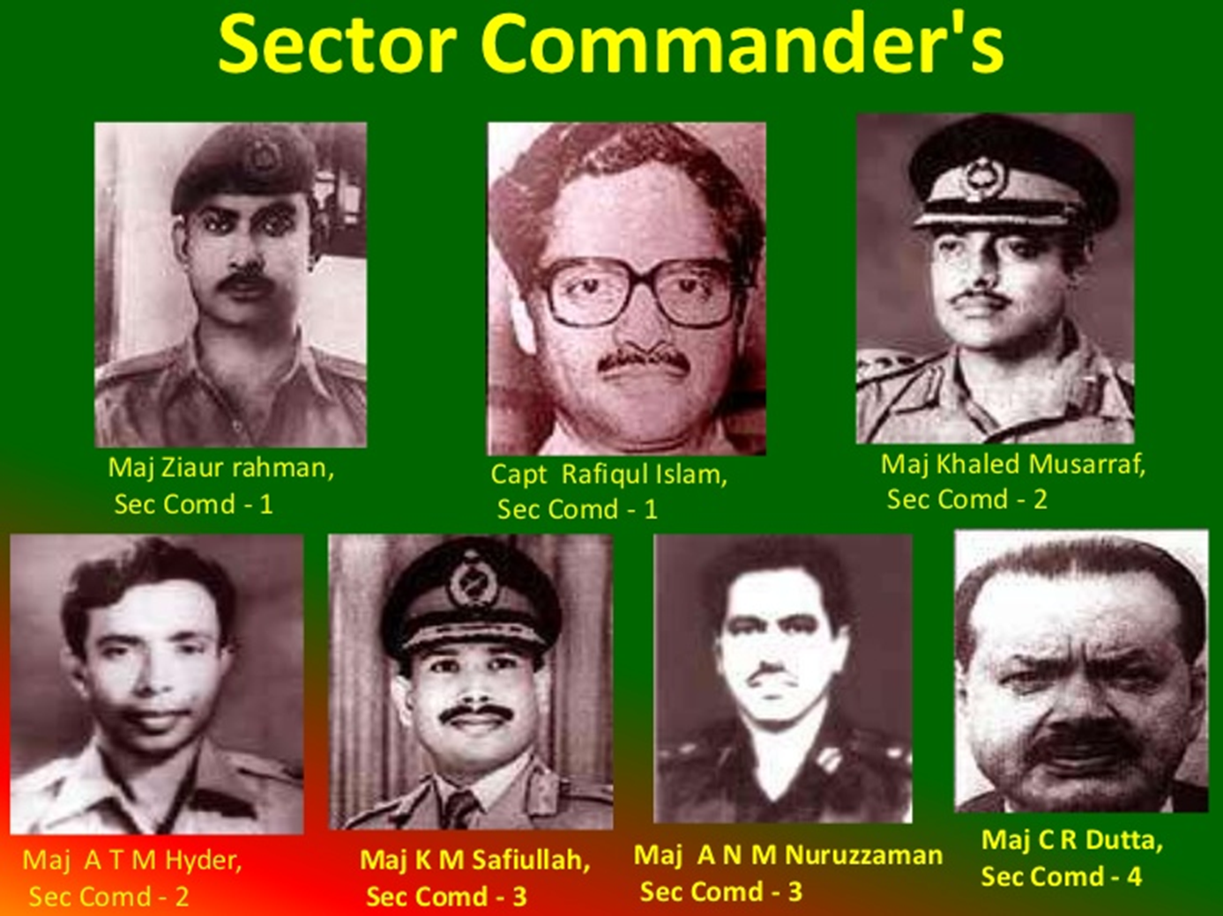

Slide 31
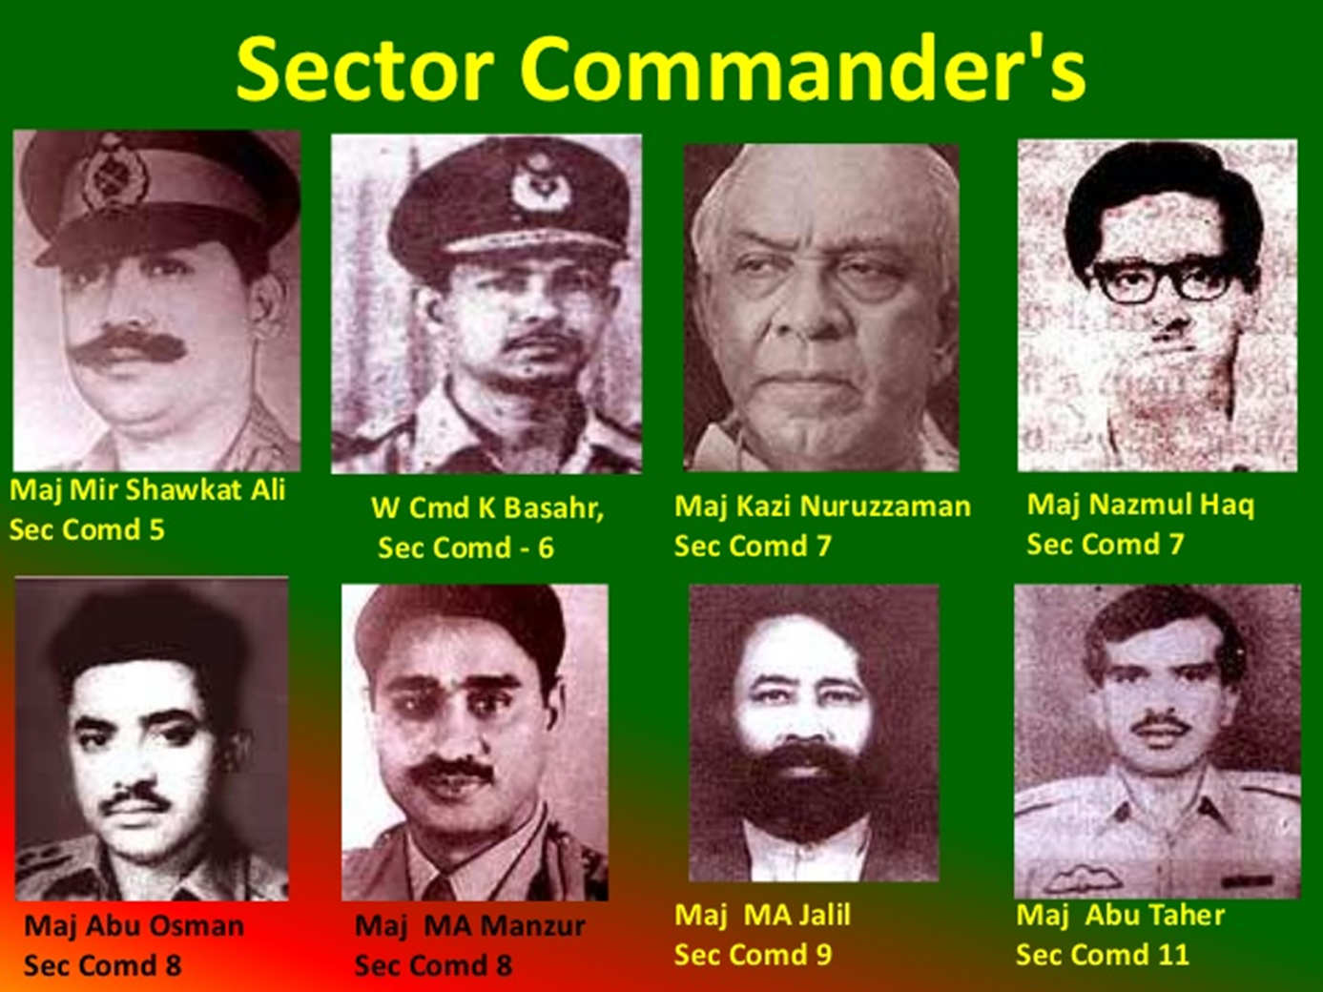

Slide 32
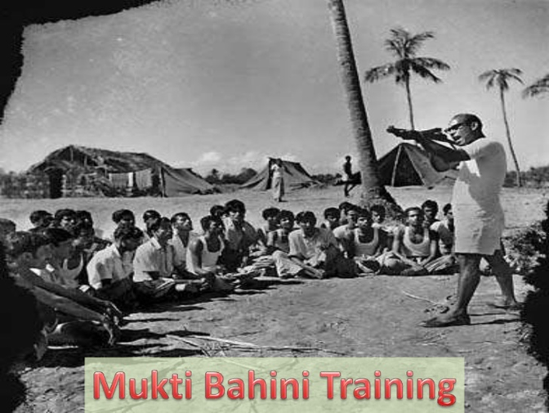

Slide 33
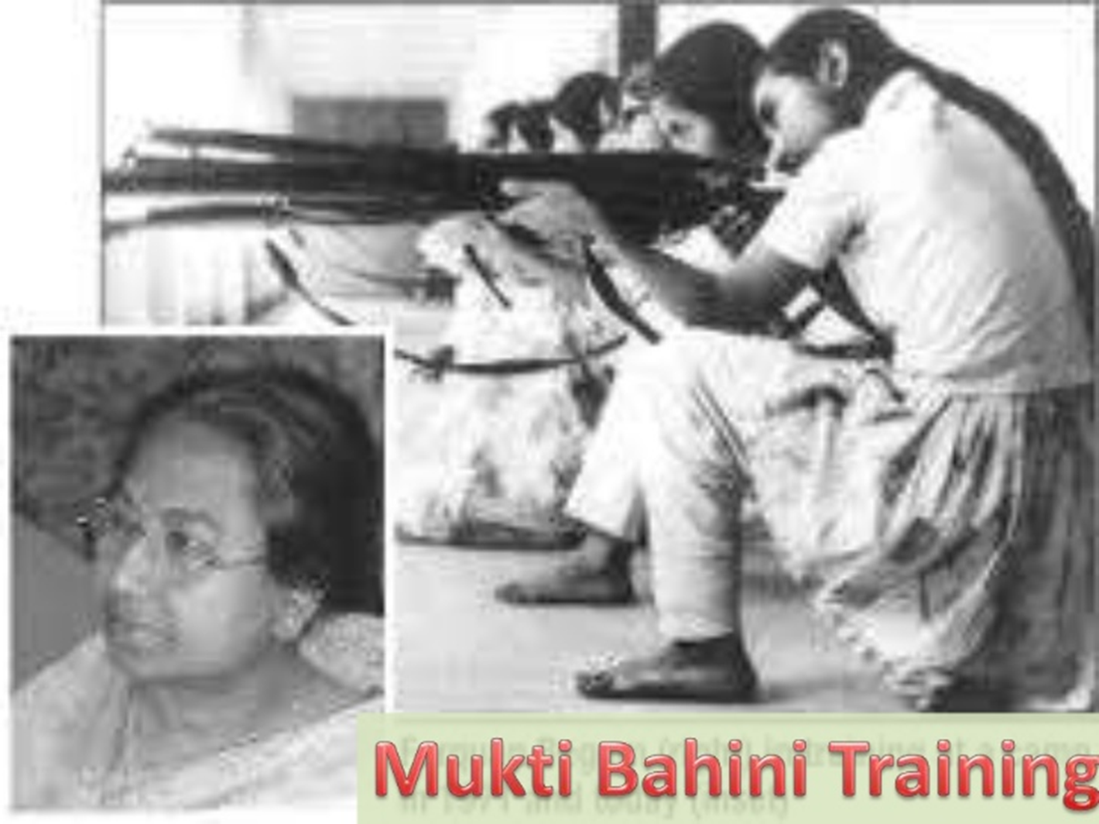

Slide 34
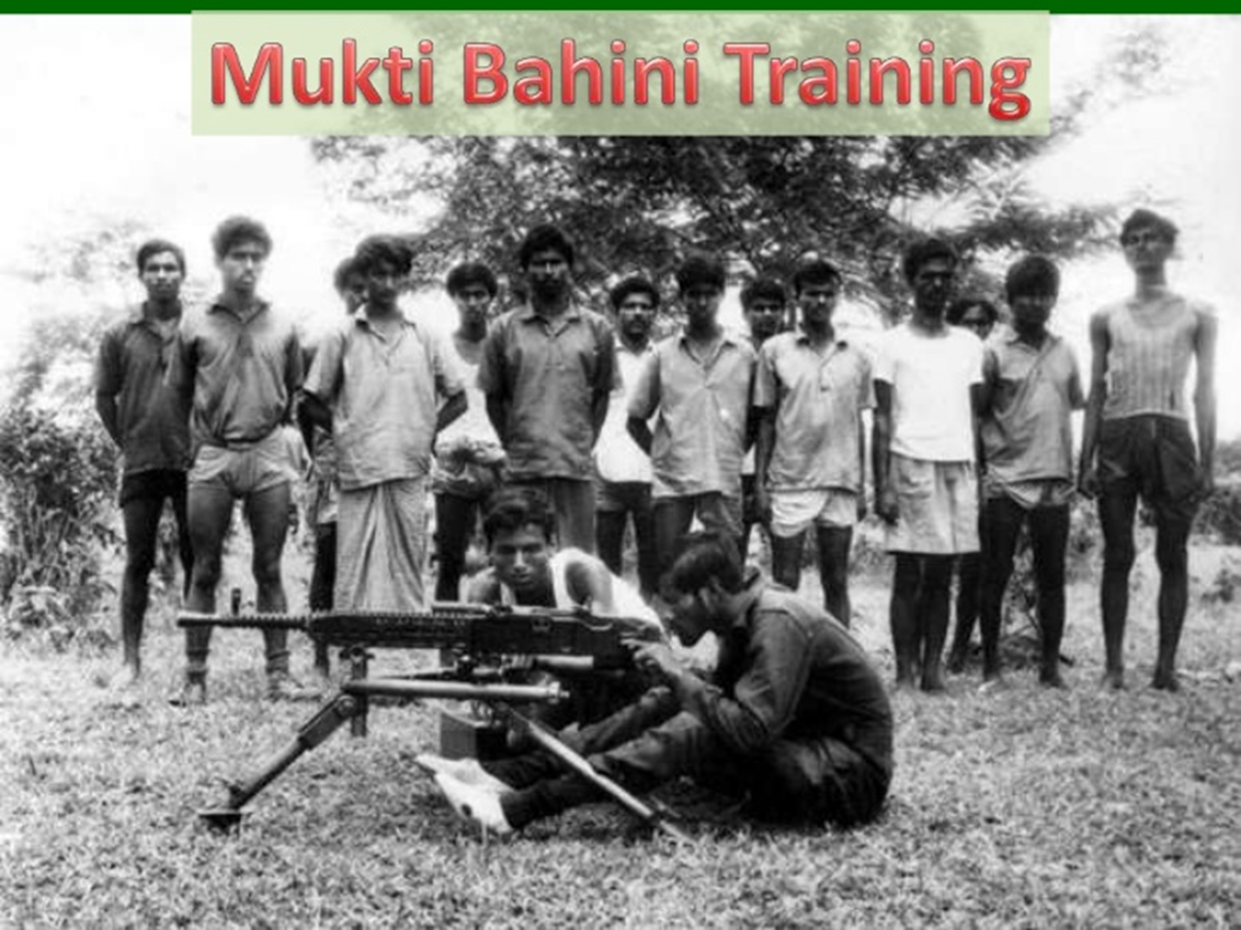

Slide 35
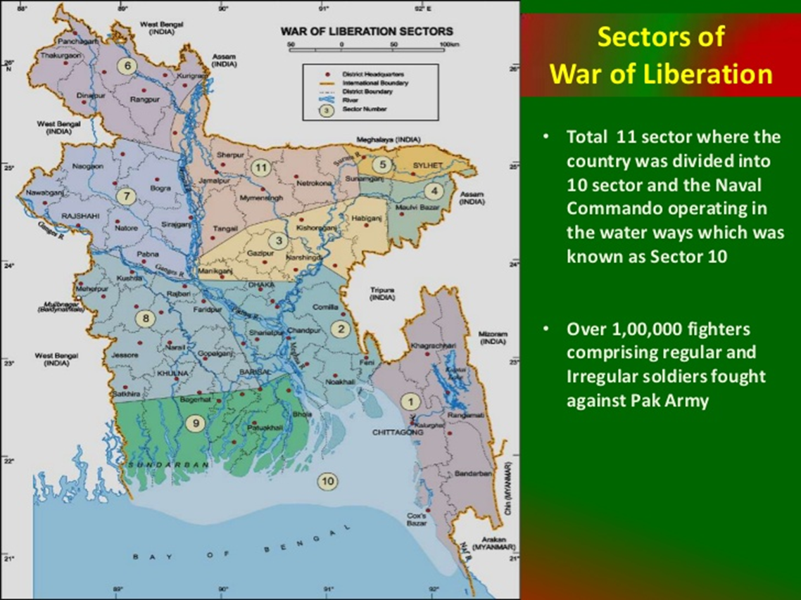

Slide 36
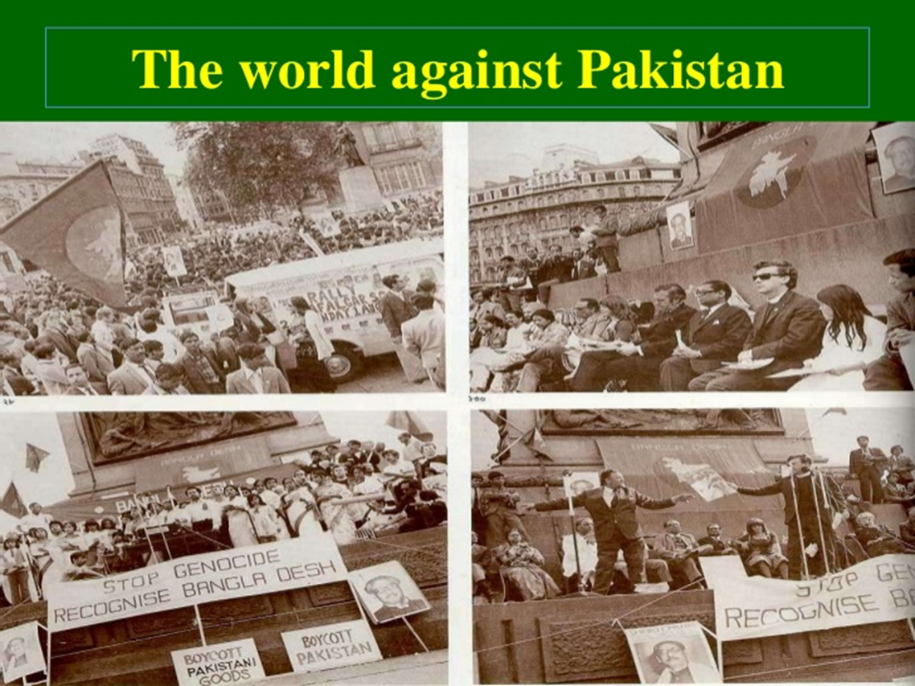

Slide 37
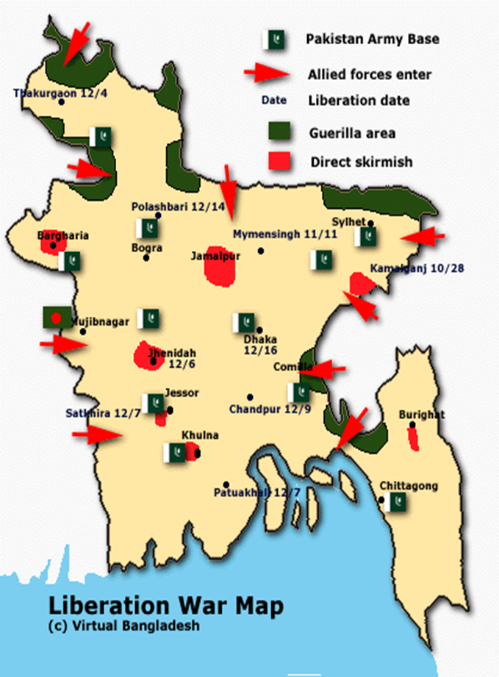
Basics Of The War
Lasted about 9 months – March 26, 1971 until December 16, 1971
India declared war on West Pakistan after the Pakistani Air Force (PAF) struck Indian airfields in northern India
The war ended 2 weeks later when India and the West had overpowered the East
Resulted in Bangladesh's independence from Pakistan

Slide 38
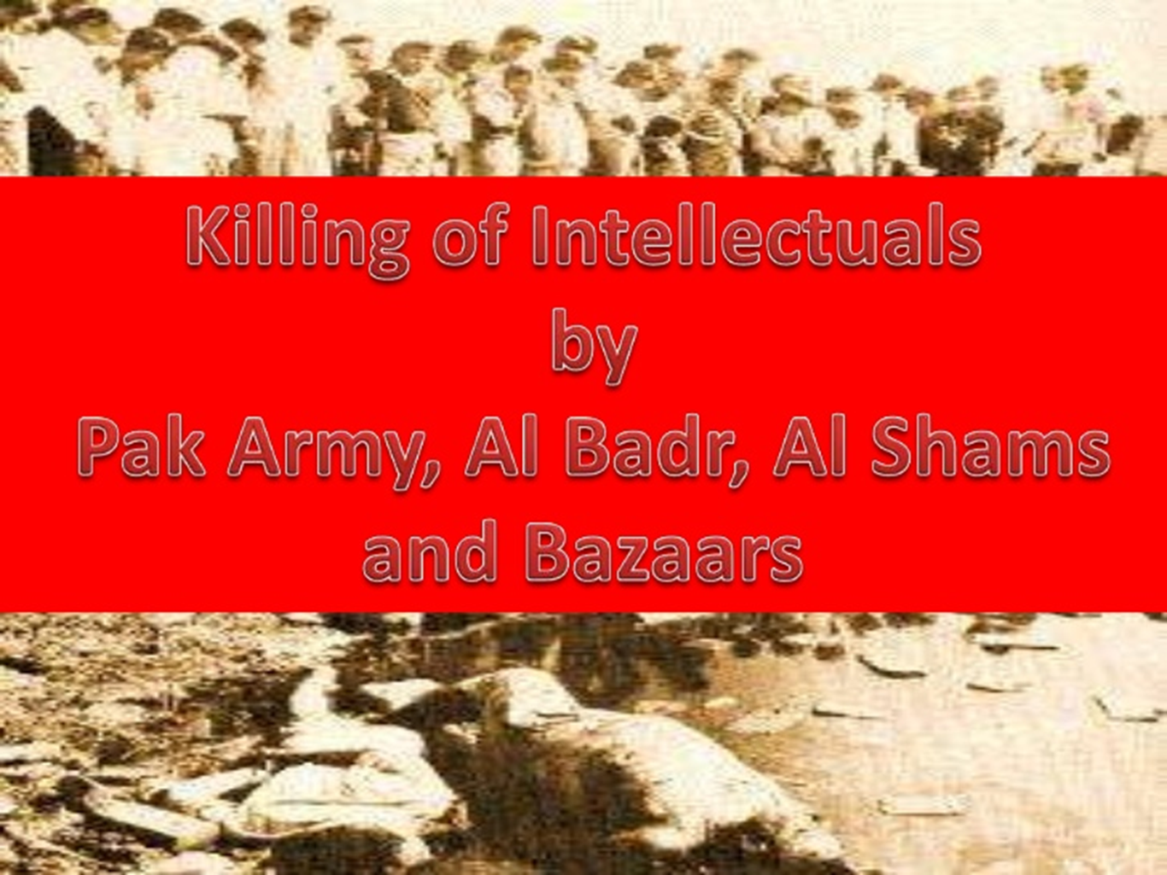

Slide 39


Slide 40
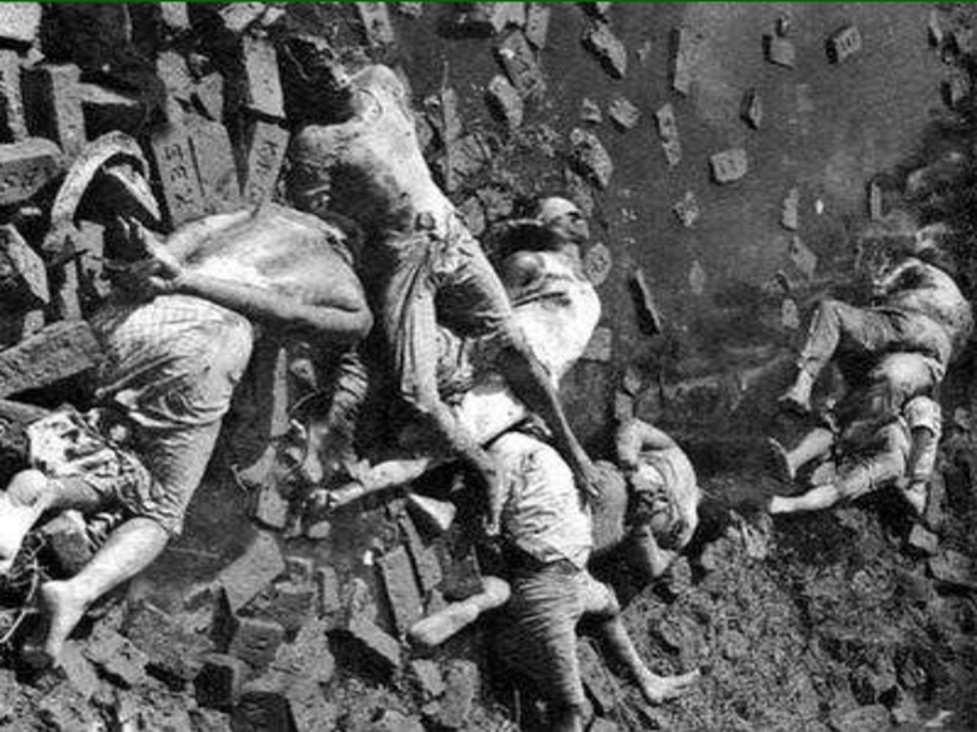

Slide 41
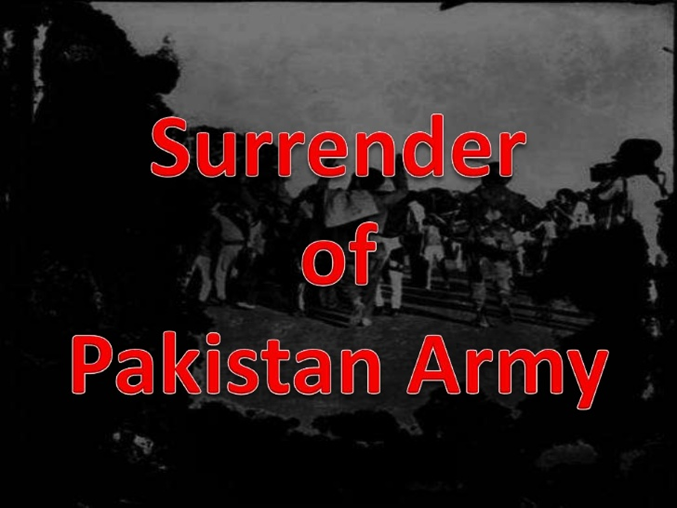

Slide 42
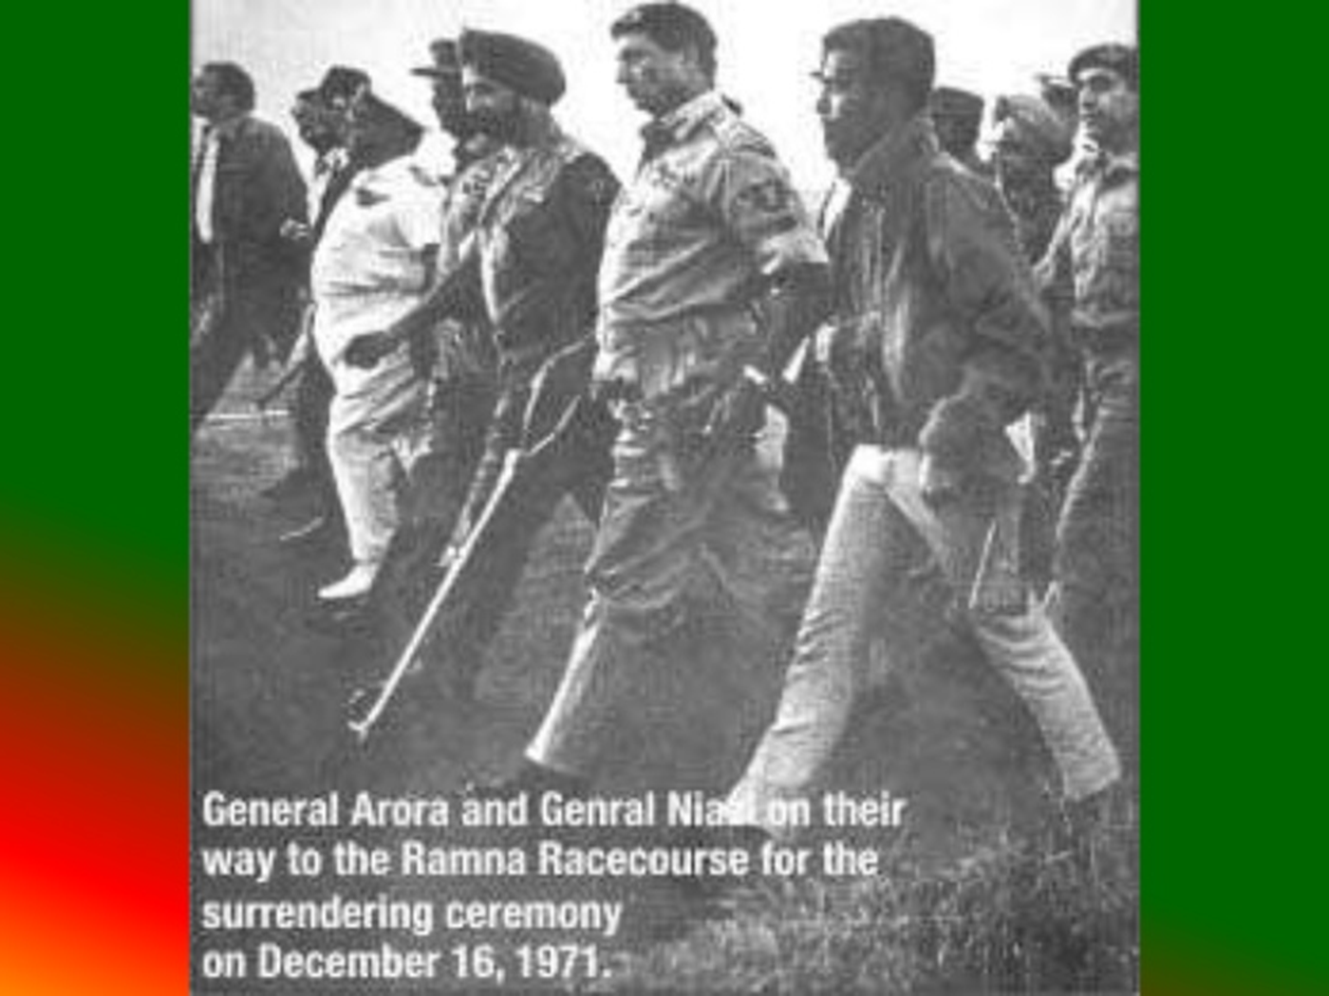

Slide 43
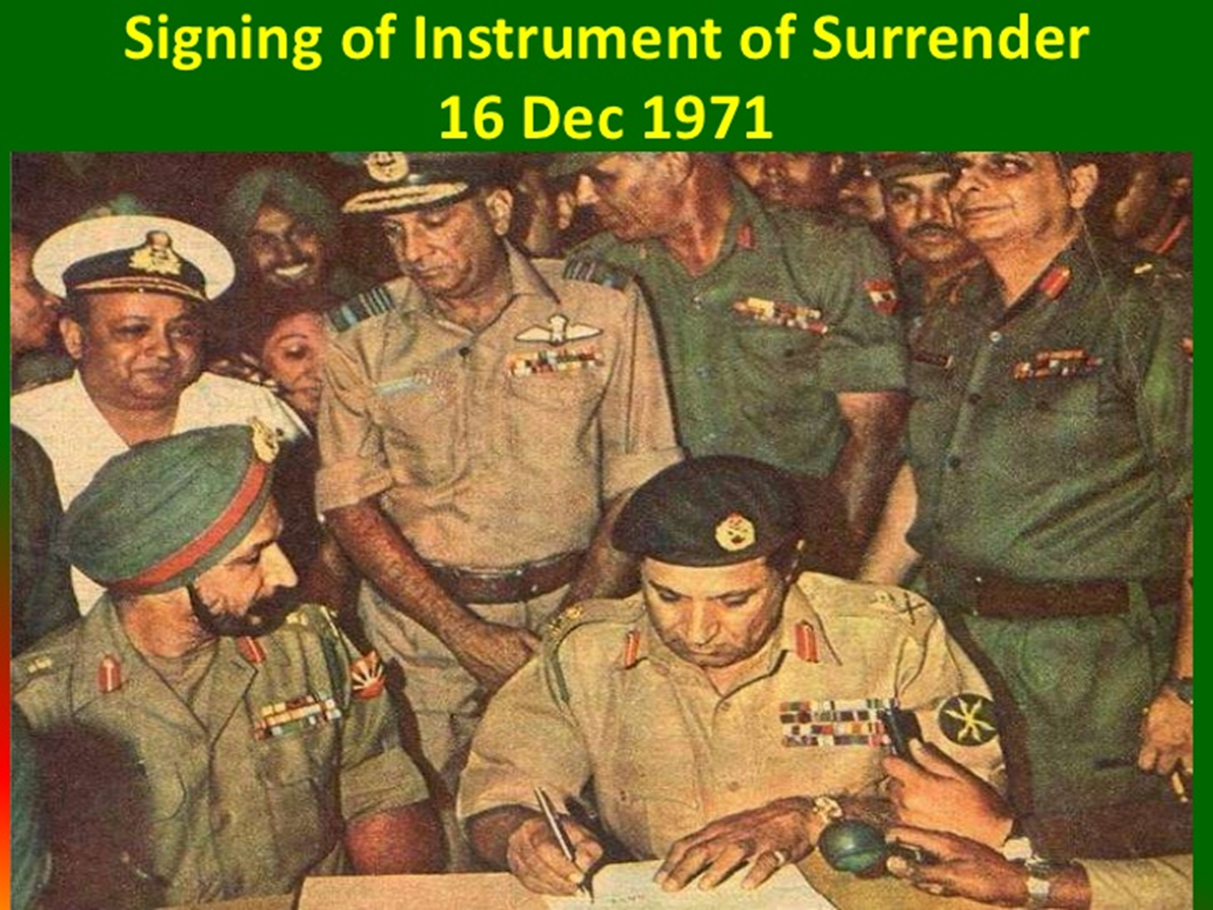

Slide 44
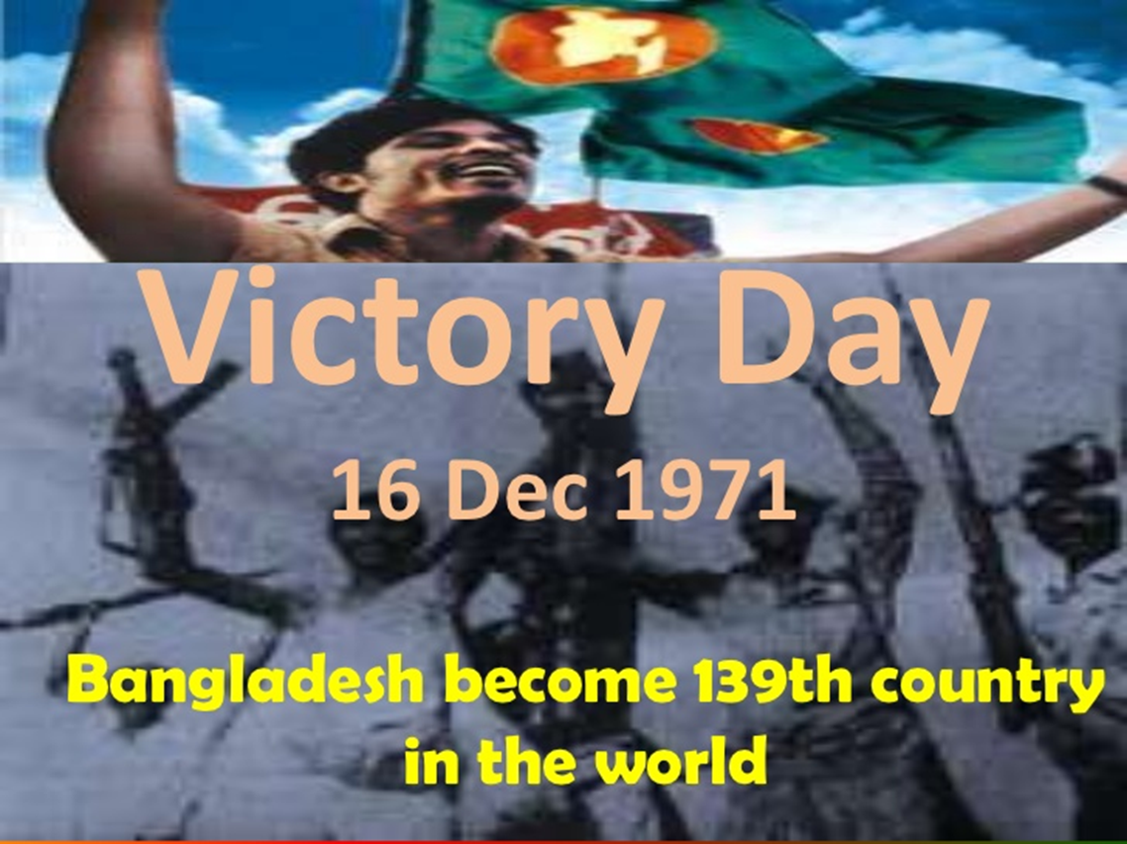

Slide 45
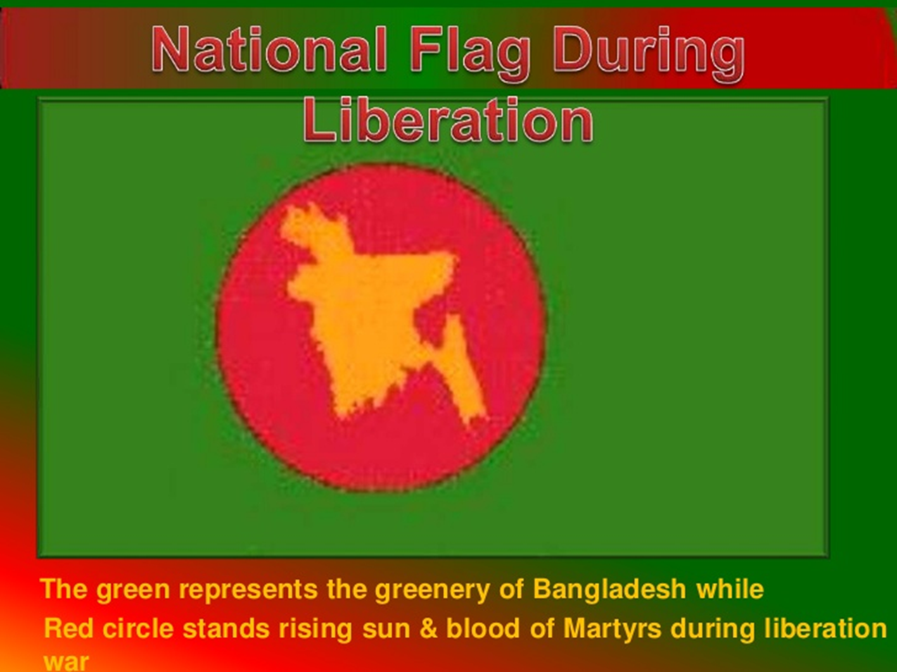

Slide 46
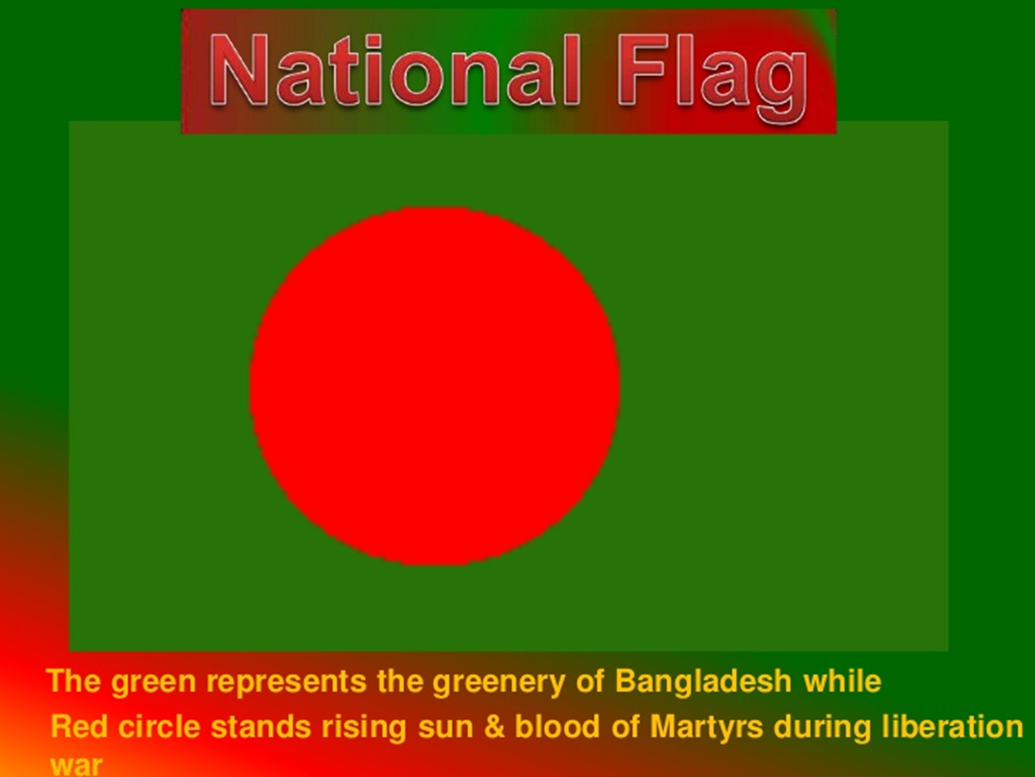

Slide 47
